Slide 1
Telecommuication
An Introduction
Christy Henitha JV
17th January, 2020

Slide 2
Table of Contents
1. History of telecommunication
2. Communication & telecommunication
3. Telecommunication Components
4. Types of telecommunication
5. Telecom Industry
6. Business process in telecom industry
7. Telecom Testing
8. Social impact of telecom industry
9. Future of telecommunication
10. Evaluation

Slide 3

1. History of telecommunication

Slide 4
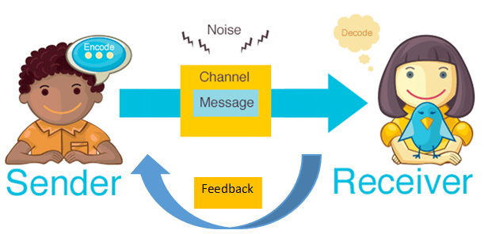
2. Communication & telecommunication
Communication occurs when there is exchange of information between sender and receiver.
When the exchange of information between participants includes the use of technology, it is called as Telecommunication

Slide 5
2. Communication & telecommunication
Telecommunication is the transmission of signs, signals, messages, words, writings, images and sounds or information of any nature by wire, radio, optical or other electromagnetic systems.
The word telecommunication was adapted from the French word telecommunication. Greek prefix tele-, meaning "far off", and the Latin communicare, meaning "to share".

Slide 6
How mobile works
3. Telecommunication Components

Slide 7
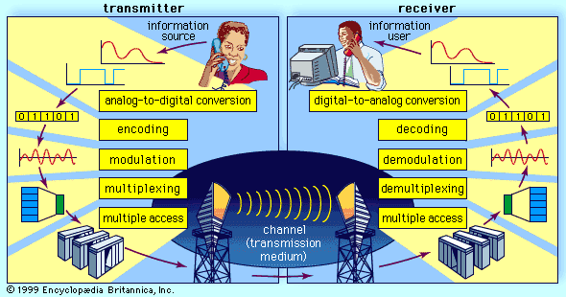
3. Telecommunication Components

Slide 8
3. Telecommunication Components
Study.com telecom components

Slide 9
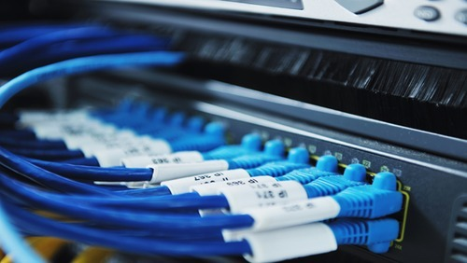
4. Types of telecommunication
POINT-TO-POINT COMMUNICATION
Telecommunication over telephone lines
BROADCAST COMMUNICATION
Telecommunication through radio broadcasts
MULTIPLEX SYSTEM
Telecommunication in which multiple transmitters and multiple receivers are used.

Slide 10
4. Types of telecommunication
WIRED Vs WIRELESS COMMUNICATION
Study.com wired

Slide 11
4. Types of telecommunication
TYPES OF NETWORK TOPOLOGY

Slide 12
5. Telecom industry
Telecom industry is becoming a top performing industry in the last few years.
Telecom industry builds, maintains and operates telecommunication network and thereby makes communication possible globally through internet or phone for a human being and this service plays a vital role in anyone’s life.
Since the shift of the telecom sector to digital and computer networks, telecommunication industry uses software indispensable.
Telecom sector depends on the various types of software components to deliver many services like routing and switching, VoIP broadband access, etc.
Hardware
Software
Network

Slide 13
6. Business process in telecom industry
Telecom services are based on the below two systems:
#1) Operations Support Systems (OSS):
OSS supports back-office activities like telecom network, provisioning, maintaining customer service, Inventory etc. Sometimes it also called as Operational Support Systems.
#2) Business Support Systems (BSS):
BSS deals with Customer Relationship Manager (CRM) and processes such as generating invoices, IVR’s Call Centers, taking orders, processing bills, collecting payments, etc. Basically, customer-facing activities are involved in Business Support Systems.

Slide 14
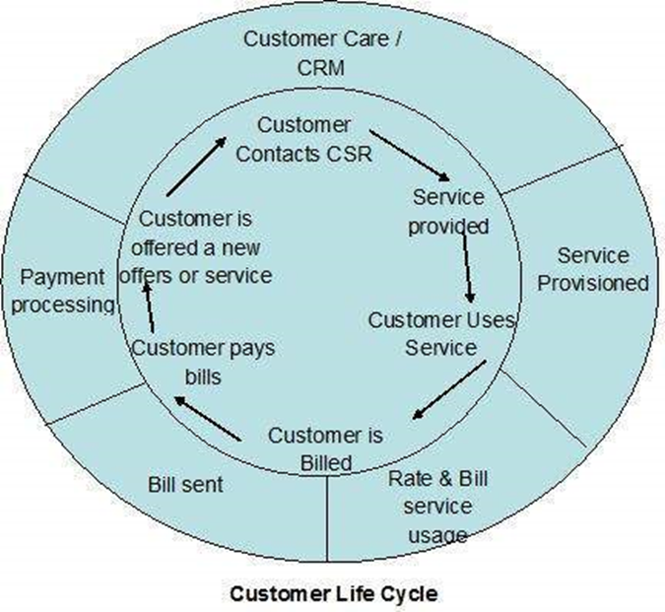
6. Business process in telecom industry
Mobile Pre-Paid Customers use Mobile services by paying their charges in advance.
Mobile Post-Paid Customers use Mobile services by paying their charges after every invoice they receive.
Fixed Pre-Paid Customers use Fixed line, i.e., landline services recharge their phone based on their requirements
Fixed Post-Paid Customers use Fixed line, i.e., landline services by paying their charges after every invoice they receive.

Slide 15
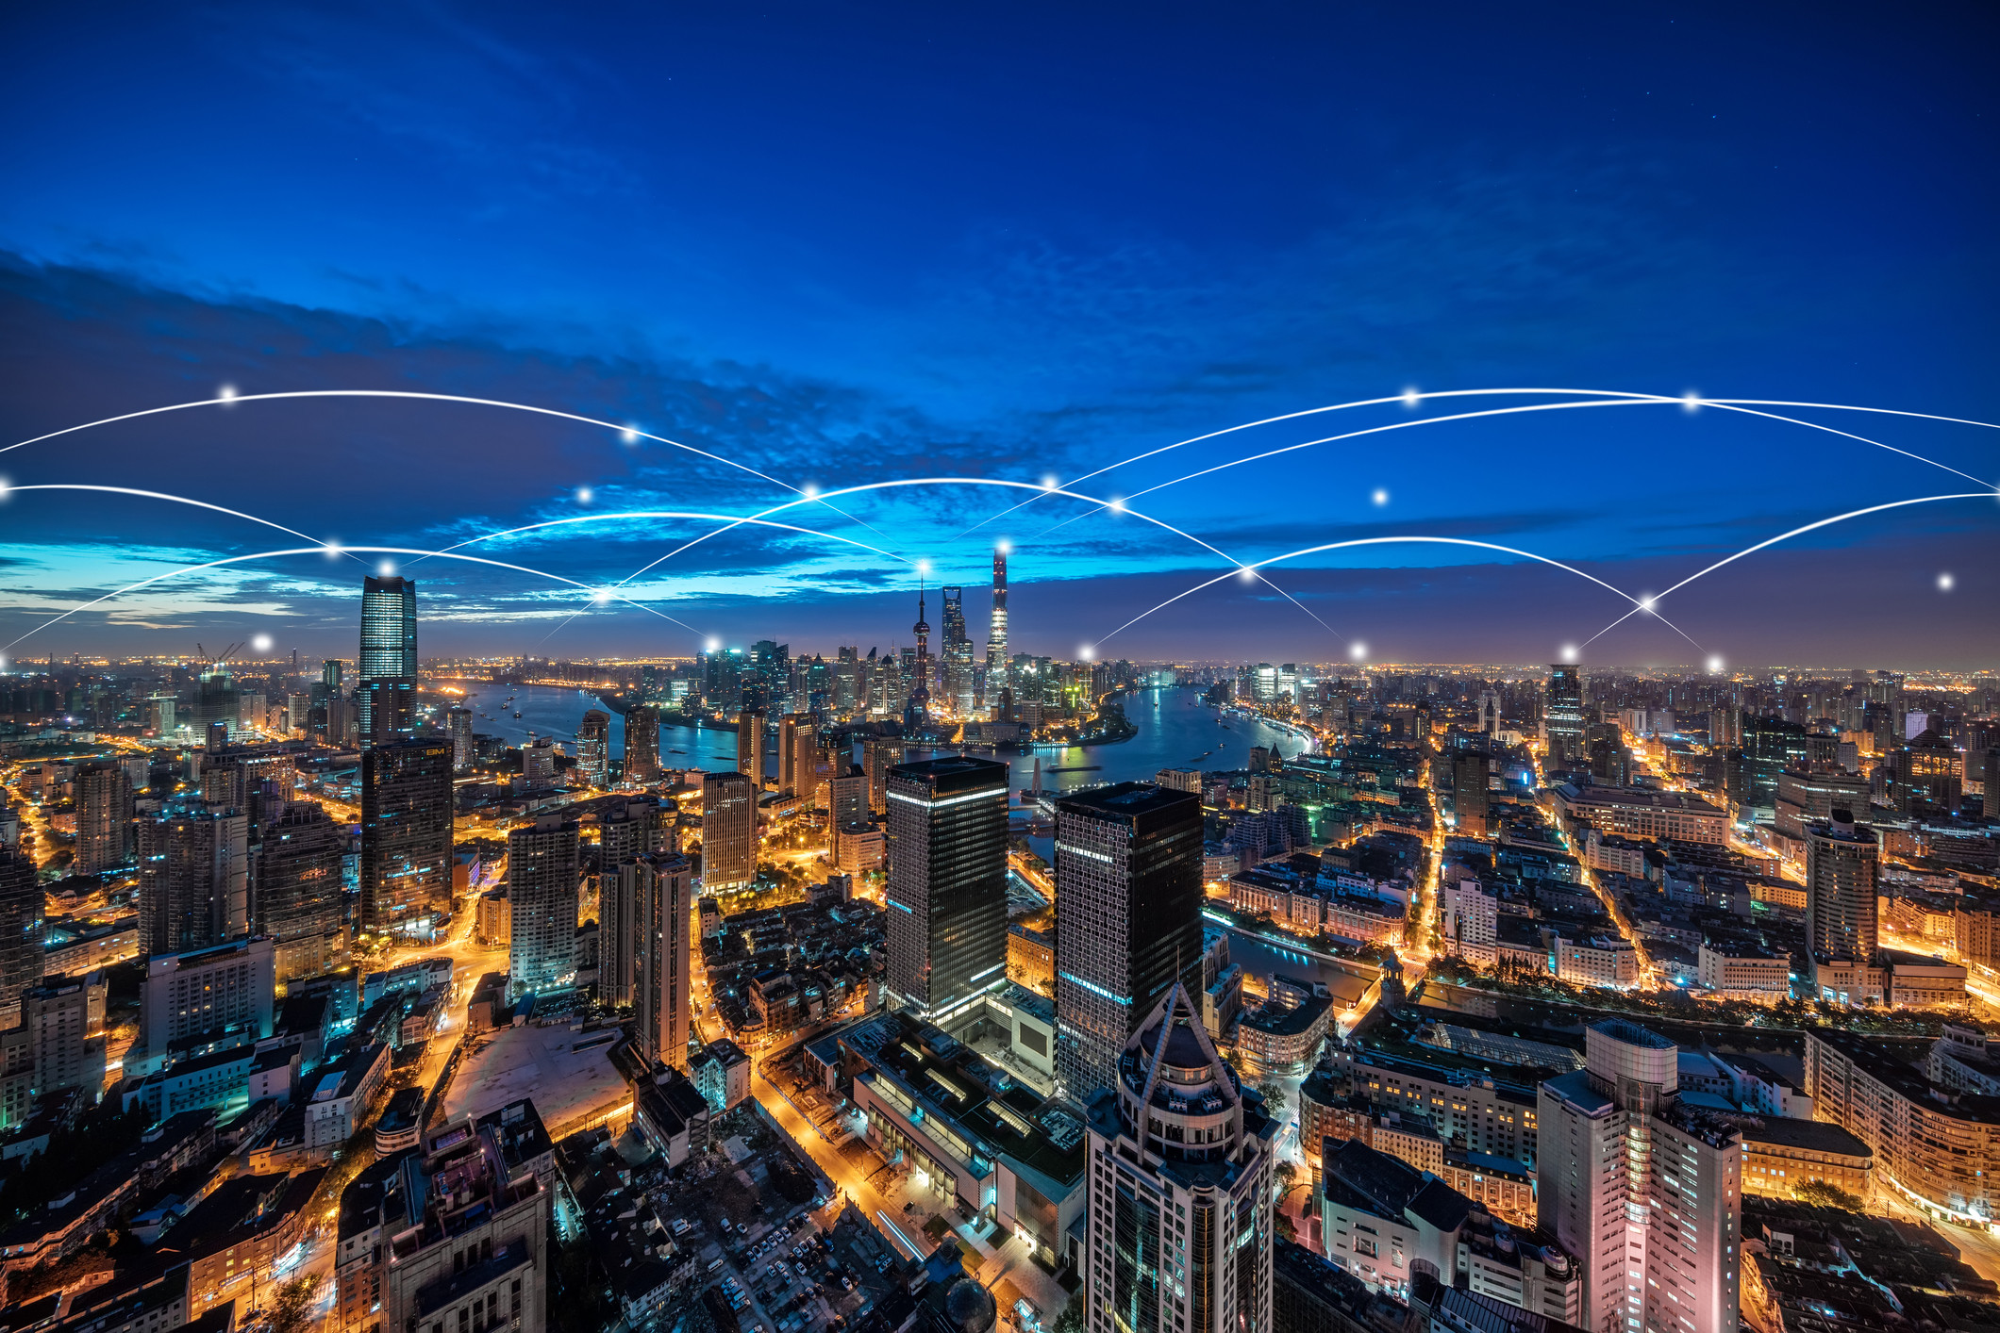
7. Telecom testing
Functional testing
Conformance testing
Interconnection testing
Performance testing
IVR testing
Interoperability testing
Protocol testing
Security testing

Slide 16
7. Telecom testing
Sample test cases - Telecom Billing System
Verify, the telephone number of the customer is registered under telecom operator
Verify whether the number is still working
Verify the number entered is valid, and it is 10 digit number
Verify the number is not blocked due to some reasons
Verify if the number has any outstanding bills, if exist, display it on screen
Verify the number has all previous accounts or bills cleared
Verify the system enables statement generation as per customer requirement
Verify the system has recorded a number of calls accurately
Verify the plan chosen by the customer displays on the billing system
Verify the total amount billed is accurate and mapped to the service offered

Slide 17
8. Social Impact
https://spark.adobe.com/video/SouueHjvnqBmk

Slide 18



8. Social Impact
Negative Impact

Slide 19
9. Future of telecommunication

Slide 20
10. Evaluation
Kahoot Quiz
https://create.kahoot.it/details/304fc120-821b-42f1-97e1-eae07cc39bdd

